Slide 1
CSE 12 – Basic Data Structures
[Slides borrowed/adapted from slides by Marina Langlois and Christine Alvarado]

Slide 2
Analyzing the worst case
boolean find( String[] theList, String toFind ) {
for ( int i = 0; i < theList.length; i++ ) {
if ( theList[i].equals(toFind) )
return true;
}
return false;
}
boolean fastFind( String[] theList, String toFind ) {
return false;
}
Which method is faster?
find
fastFind
They are about the same

Slide 3
Running time: What version of the problem are you analyzing
One part of figuring out how long a program takes to run is figuring out how “lucky” you got in your input.
You might get lucky (best case), and require the least amount of time possible
You might get unlucky (worst case) and require the most amount of time possible
Or you might want to know “on average” (average case) if you are neither lucky or unlucky, how long does an algorithm take.
Almost always, what we care about is the WORST CASE or the AVERAGE CASE. Best case is usually not that interesting, unless we can prove it's slow!
In CSE 12 when we do analysis, we are doing WORST CASE analysis unless otherwise specified.

Slide 4


Big-O
We say a function f(n) is “big-O” of another function g(n), and write f(n) = O(g(n)), if there are positive constants c and n₀ such that:
f(n) ≤ c g(n) for all n ≥ n₀.
In other words, for large n, can you multiply g(n) by a constant and have it always be bigger than or equal to f(n)
n is the “size of your problem”

Slide 5
Steps for calculating the Big O (Theta, Omega) bound on code or algorithms
Identify the assumptions you’re making about input and the case you’re studying – best, worst, average?
Count the number of instructions in your code (or algorithm) as precisely as possible as a function the size of your input (e.g. the length of the array). Call this f(n)
Summarize your findings by relating f(n) to a simpler g(n) such that f(n) = O(g(n))

Slide 6
f₂ is* O(f₁)
f(n) = O(g(n)), if there are positive constants c and n₀ such that f(n) ≤ c * g(n) for all n ≥ n₀.
TRUE
FALSE
Why or why not?
f₁
f₂
* You can’t actually tell if you don’t know the function, because it could do something crazy just off the graph, but we’ll assume it doesn’t.

Slide 7
f(n) is O(g(n)), if there are positive constants c and n₀ such that f(n) ≤ c * g(n) for all n ≥ n₀.
f₂ is O(f₁) because f₁ > f₂ (after about n=10, so we set n₀ = 10)
f₁ is clearly an upper bound on f₂ and that’s what big-O is all about
f₁
f₂

Slide 8


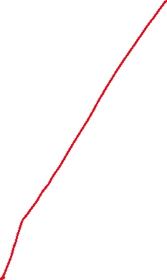
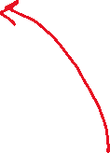

f₁ is O(f₂)
f(n) = O(g(n)), if there are positive constants c and n₀ such that f(n) ≤ c * g(n) for all n ≥ n₀.
TRUE
FALSE
Why or why not?
In other words, for large n, can you multiply f₂ by a constant and have it always be bigger than f₁ for large enough n?

Slide 9
f(n) = O(g(n)), if there are positive constants c and n₀ such that f(n) ≤ c * g(n) for all n ≥ n₀.
f₂ is O(f₁) because f₁ > f₂ (after about n=10, so we set n₀ = 10)
f₁ is clearly an upper bound on f₂ and that’s what big-O is all about
But f₁ = O(f₂) as well!
We just have to use the “c” to adjust so f₂ that it moves above f₁
f₁
f₂

Slide 10

f₁ is O(f₃)
f(n) = O(g(n)), if there are positive constants c and n₀ such that f(n) ≤ c * g(n) for all n ≥ n₀.
f₃
TRUE
FALSE
Why or why not?
f₁
f₂

Slide 11
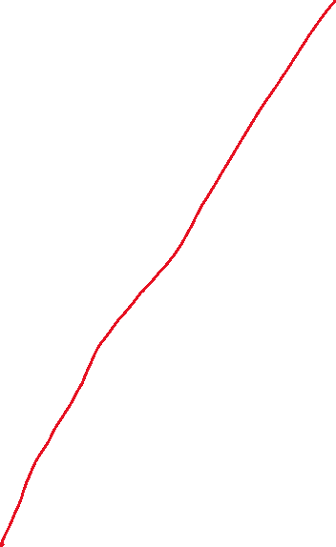
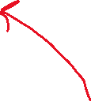



f₃ is O(f₁)
f(n) = O(g(n)), if there are positive constants c and n₀ such that f(n) ≤ c * g(n) for all n ≥ n₀.
f₃
TRUE
FALSE
Why or why not?
f₁
f₂

Slide 12
f₁ = O(f₃) but f₃ ≠ O(f₁)
There is no way to pick a c that would make an O(n) function (f₁) stay above an O(n²) function (f₃).
f₃
f₁
f₂

Slide 13
Common Big-O confusions when trying to argue that f₂ is O(f₁):
What if we multiply f₂ by a large constant, so that c*f₂ is larger than f₁ ? Doesn’t that mean that f₂ is not O(f₁)? No, because the definition asks us to find some constants that fit. Having some other constants that don’t work is fine.
What about when n is less than 10? Isn’t f2 larger than f1? Remember, we get to pick our n0, and only consider n larger than n0.
f₁
f₂

Slide 14
Shortcuts for calculating
Big-O analysis starting with a function characterizing the growth in cost of the algorithm

Slide 15
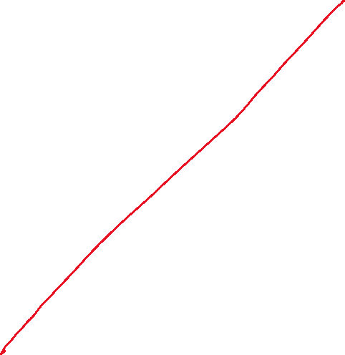

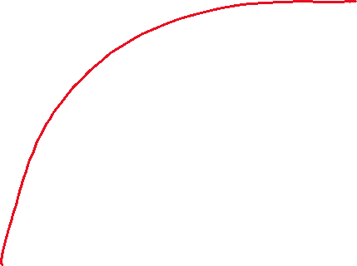
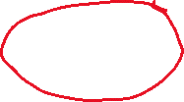



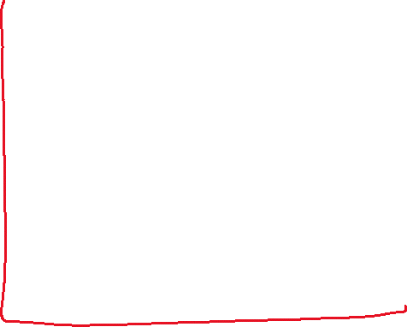

Let f(n) = 3 log₂ n + 4 n log₂ n + n
Which of the following is true?
f(n) is O(log₂n)
f(n) is O(nlog₂n)
f(n) is O(n²)
f(n) is O(n)
More than one of these

Slide 16



Let f(n) = 546 + 34n + 2n²
Which of the following is NOT a correct bound?
f(n) is O(2^{n})
f(n) is O(n²)
f(n) is O(n)
f(n) is O(n³)

Slide 17


Let f(n) = 2^{n} + 14n² + 4n³
Which of the following is true?
f(n) is O(2^{n})
f(n) is O(n²)
f(n) is O(n)
f(n) is O(n³)
More than one of these

Slide 18
Let f(n) = 100
Which of the following is NOT a correct bound?
f(n) is O(2^{n})
f(n) is O(n²)
f(n) is O(n)
f(n) is O(n¹⁰⁰)
None of these

Slide 19

O is an upper bound Ω is a lower bound
We say a function f(n) is “big-omega” of another function g(n), and write f(n) = Ω(g(n)), if there are positive constants c and n₀ such that:
f(n) ≥ c g(n) for all n ≥ n₀.
In other words, for large n, can you multiply g(n) by a constant and have it always be smaller than or equal to f(n)

Slide 20
f₂ is Ω(f₁)
TRUE
FALSE
Why or why not?
f₁
f₂
In other words, for large n, can you multiply f₁ by a positive constant and have it always be smaller than f₂

Slide 21
f(n) = O(g(n)), if there are positive constants c and n₀ such that f(n) ≤ c * g(n) for all n ≥ n₀.
f(n) = Ω(g(n)), if there are positive constants c and n₀ such that f(n) ≥ c * g(n) for all n ≥ n₀.
f₁ is Ω(f₂) because f₁ > f₂ (after about n=10, so we set n₀ = 10)
f₂ is clearly a lower bound on f₁ and that’s what big-Ω is all about
But f₂ is Ω(f₁) as well!
We just have to use the “c” to adjust so f₁ that it moves below f₂
f₁
f₂
c * f₁

Slide 22

f₃ is Ω(f₁)
f(n) = O(g(n)), if there are positive constants c and n₀ such that f(n) ≤ c * g(n) for all n ≥ n₀.
f(n) = Ω(g(n)), if there are positive constants c and n₀ such that f(n) ≥ c * g(n) for all n ≥ n₀.
f₃
TRUE
FALSE
Why or why not?
f₁
f₂

Slide 23

f₁ is Ω(f₃)
f(n) = O(g(n)), if there are positive constants c and n₀ such that f(n) ≤ c * g(n) for all n ≥ n₀.
f(n) = Ω(g(n)), if there are positive constants c and n₀ such that f(n) ≥ c * g(n) for all n ≥ n₀.
f₃
TRUE
FALSE
Why or why not?
f₁
f₂

Slide 24
f₃ = Ω(f₁) but f₁ ≠ Ω(f₃)
There is no way to pick a c that would make an O(n²) function (f₃) stay below an O(n) function (f₁).
f₃
f₁

Slide 25
Summary
Big-O
Big-Ω
Upper bound on a function
f(n) = O(g(n)) means that we can expect f(n) will always be under the bound g(n)
But we don’t count n up to some starting point n₀
And we can “cheat” a little bit by moving g(n) up by multiplying by some constant c
Lower bound on a function
f(n) = Ω(g(n)) means that we can expect f(n) will always be over the bound g(n)
But we don’t count n up to some starting point n₀
And we can “cheat” a little bit by moving g(n) down by multiplying by some constant c

Slide 26
Big-θ
Tight bound on a function.
If f(n) = O(g(n)) and f(n) = Ω(g(n)), then f(n) = θ(g(n)).
Basically it means that f(n) and g(n) are interchangeable
Examples:
3n+20 = θ(10n+7)
5n² + 50n + 3 = θ(5n² + 100)

Slide 27
f₁ is Θ(f₂)
TRUE
FALSE
Why or why not?
f₁
f₂

Slide 28
f₁ is Θ(f₂)
TRUE
FALSE
Why or why not?
Since f₁ is O(f₂) and Ω(f₂), it is also Θ(f₂) (this is the definition of big-Theta)
f₁
f₂

Slide 29
f₁ is Θ(f₃)
TRUE
FALSE
Why or why not?
f₃
f₁
f₂

Slide 30
Big-θ and sloppy usage
Sometimes people say, “This algorithm is O(n²)” when it would be more precise to say that it is θ(n²)
They are intending to give a tight bound, but use the looser “big-O” term instead of the “big-θ” term that actually means tight bound
Not wrong, but not as precise
I don’t know why, this is just a cultural thing you will encounter among computer scientists

Slide 31
Count how many times each line executes, then say which Θ( ) statement(s) is(are) true.
Line #
int maxDifference(int[] arr){
max = 0;
for (int i=0; i<arr.length; i++) {
for (int j=0; j<arr.length; j++) {
if (arr[i] – arr[j] > max)
max = arr[i] – arr[j];
}
}
return max;
}
1
2
3
4
5
6
7
8
9
f(n) = θ(2^{n})
f(n) = θ(n²)
f(n) = θ(n)
f(n) = θ(n³)
Other/none/more
(assume n = arr.length)

Slide 32
Count how many times each line executes, then say which Θ( ) statement(s) is(are) true.
int sumTheMiddle(int[] arr){
int range = 100;
int start = arr.length/2 – range/2;
int sum = 0;
for (int i=start; i<start+range; i++)
{
sum += arr[i];
}
return max;
}
f(n) = θ(2^{n})
f(n) = θ(n²)
f(n) = θ(n)
f(n) = θ(1)
None of these
(assume n = arr.length)

Slide 33
Count how many times each line executes, then say which Θ( ) statement(s) is(are) true.
int sumTheMiddle(int[] arr){
int range = arr.length/100;
int start = arr.length/2 – range/2;
int sum = 0;
for (int i=start; start+range; i++)
{
sum += arr[i];
}
return sum;
}
f(n) = θ(2^{n})
f(n) = θ(n²)
f(n) = θ(n)
f(n) = θ(1)
None of these
(assume n = arr.length)

Slide 34
With worst case analysis, which algorithm has the better (smaller) Big-Θ bound?
boolean find( String[] theList, String toFind ) {
for ( int i = 0; i < theList.length; i++ ) {
if ( theList[i].equals(toFind) )
return true;
}
return false;
}
boolean fastFind( String[] theList, String toFind ) {
return false;
}
find
fastFind
They are the same

Slide 35
With best case analysis, which algorithm has the better Big-Θ bound?
boolean find( String[] theList, String toFind ) {
for ( int i = 0; i < theList.length; i++ ) {
if ( theList[i].equals(toFind) )
return true;
}
return false;
}
boolean fastFind( String[] theList, String toFind ) {
return false;
}
find
fastFind
They are the same

Slide 36
Big-O means upper bound NOT worst case
The many ways to do running time analysis Any combination of purple and green OK!
Which version of the problem?
Best case
Average case
Worst case
What kind of bound?
Upper bound (O)
Lower bound (Ω)
Tight bound (Θ)
Most common combination

